Slide 1
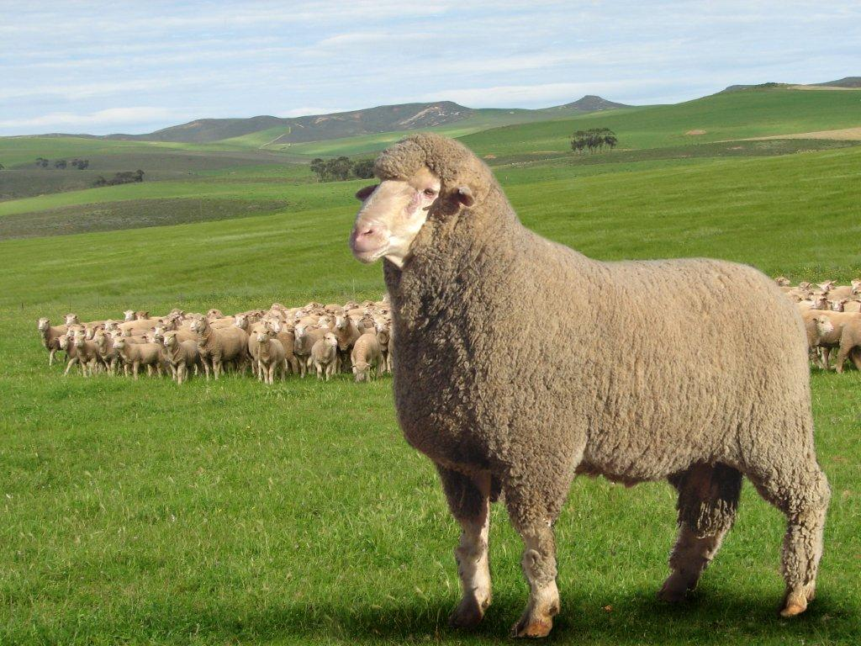

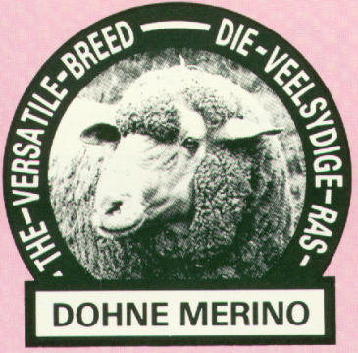
DOHNE WORKSHOPS - AUSTRALIA 2016
CAMERON McMASTER
Email: cameron@haznet.co .za

Slide 2
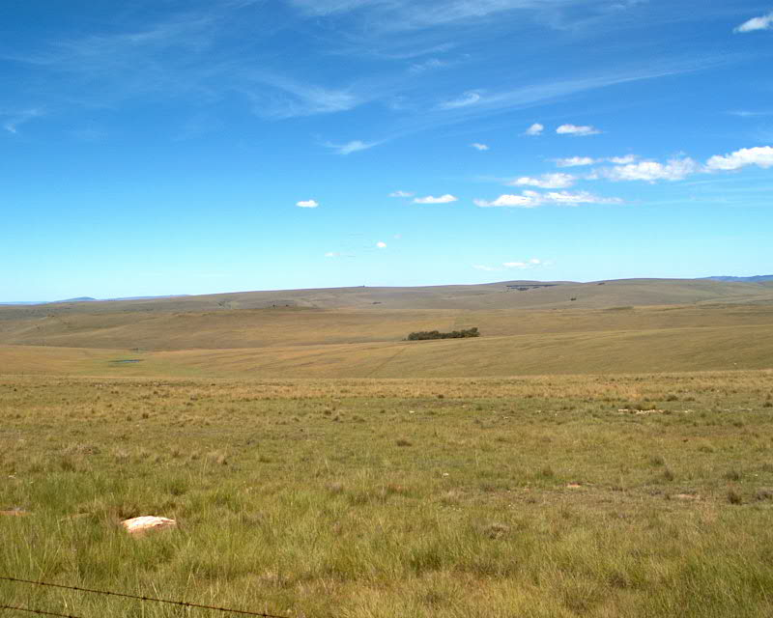
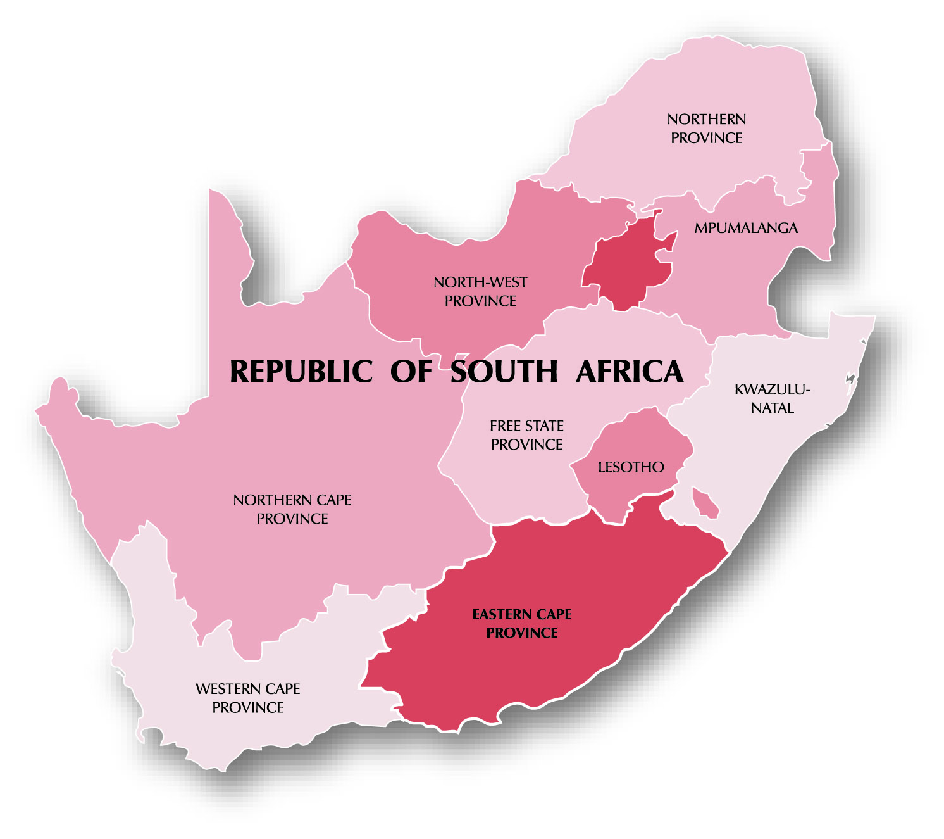

DOHNE WORKSHOPS - AUSTRALIA 2016
The coarse native grassland of the Eastern Cape (Sourveld)
is a very harsh environment for Merinos.
1939
A programme initiated at the Dohne Agricultural Research Institute to introduce genotypes for hardiness, fertility and better growth rate into the local Peppin type Merino.
OBJECTIVE: To breed a well adapted dual-purpose, fine-woolled Merino-type for harsh environments.
Dohne Agricultural Research Institute

Slide 3
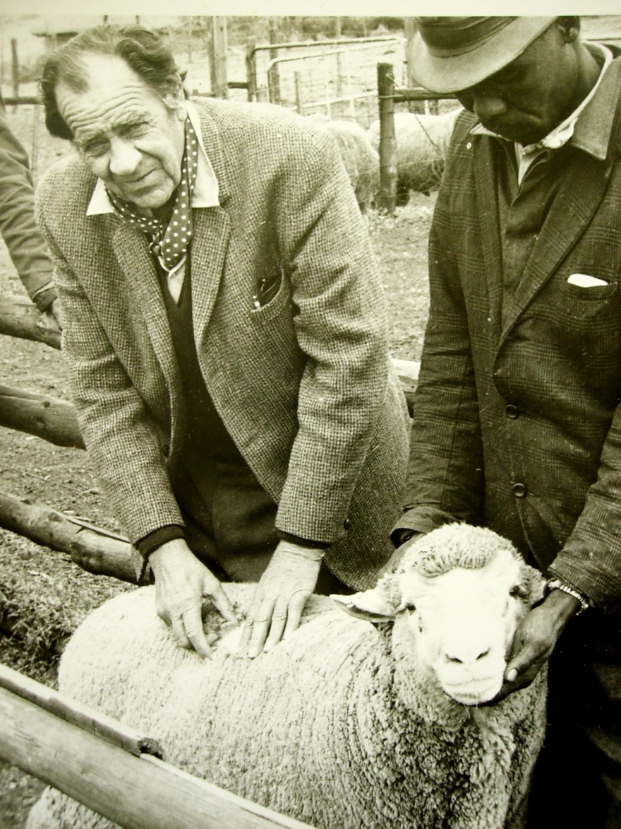
DOHNE WORKSHOPS - AUSTRALIA 2016
Mr JJJ (Koot Kotzé) Father of the Dohne
1939 German Mutton Merino x Merino. The excellent characteristics of the first cross fixed, through inter-breeding and selection.
Parameters:
Pedigrees and performance recorded.
Sheep to be run under identical conditions in a natural commercial environment.
He defined the selection procedures that are followed to this day.
Very advanced requirements at this time (the early and mid 1940s)
By observing the most productive and best adapted sheep in each generation, Koot Kotzé himself defined the ideal breed type.

Slide 4
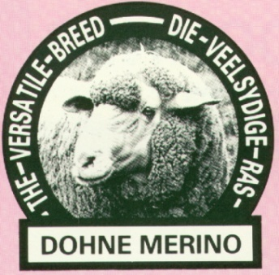
1966—Breed Society formed
Uninhibited by traditional systems we were able to embrace innovative methods
- Open Nucleus Systems and Population Genetics
- Measurement and Production Recording
A New Role defined: To improve productivity by
    Setting goals that contribute to cash income
of commercial breeders
    Breeding more efficient and better-adapted sheep
    Advanced breeding and selection systems
    Motivation and education of breeders and clients.
\\

Slide 5
Dohne Merino Breed Society of SA - Role and Functions
Quality Control
Appointment of Inspectors and supervision of Inspection Service
Regular revision of Selection Objectives and Breed Type
Norms and standards adapted when necessary (Ram Selection Index)
Merit Register – Qualification standards and evaluation of semen donors
Training and Education
Annual 4-day courses commenced in 1966
Attendance of course compulsory for Registered breeders
Senior Course - a minimum qualification for Inspectors
Courses held annually at numerous venues to cover the country
Courses later extended - 2-day courses for Agricultural students
(Universities, Technicons and Agricultural Colleges)
1-day Workshops for commercial breeders
Courses updated with advances in breeding and technology
COURSES A POWERFUL TOOL FOR PROMOTION

Slide 6
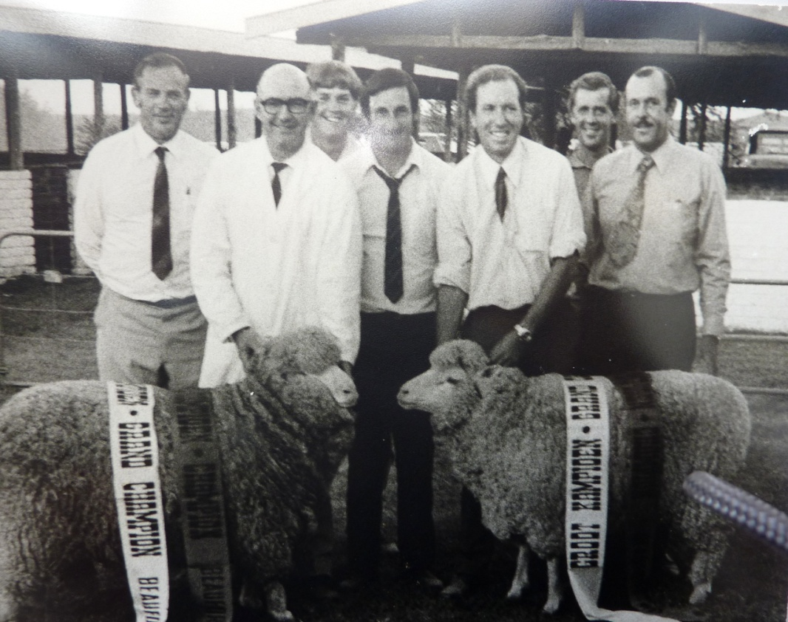
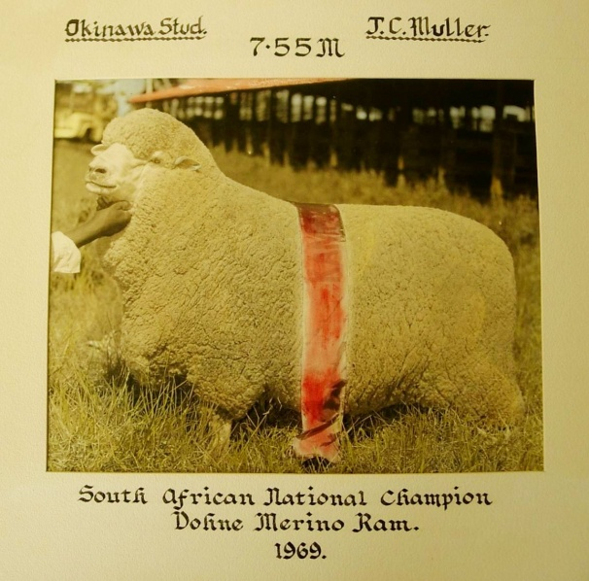
Competitive Shows scrapped in 1978
The success of a stud was now determined by its performance in a commercial environment - not by its performance in the show ring.
All animals now evaluated according to their measured relative efficiency in a commercial environment. Breeders reluctant to isolate sheep for show preparation.
Show success no longer of any use to breeders or their clients.
X
X
1973

Slide 7
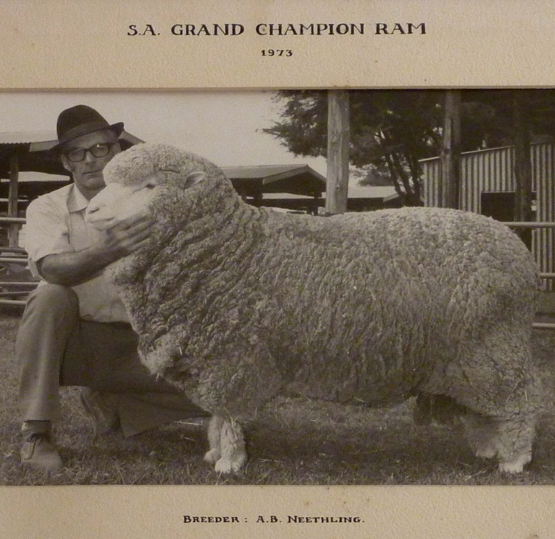
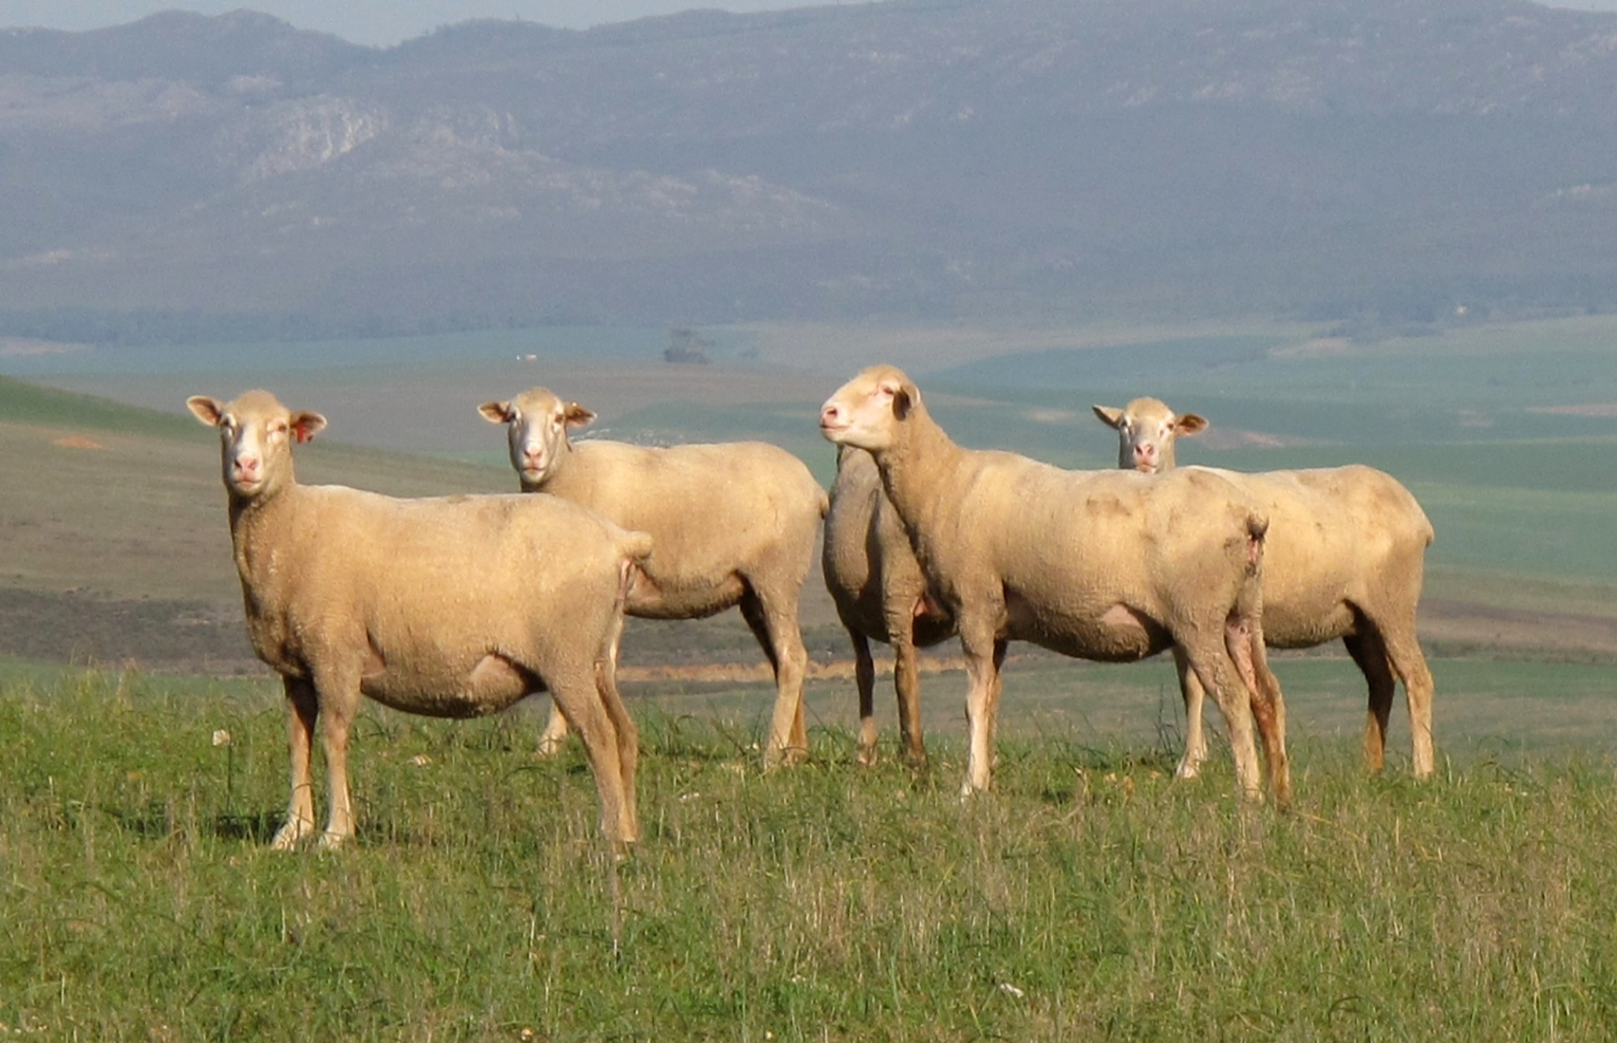
Nature is better than a show judge
When selecting on measurement in a natural
commercial situation, Nature is far better at
defining and demonstrating the most efficient
type of animal.
X
A vigorous and plain-bodied type began to emerge.

Slide 8
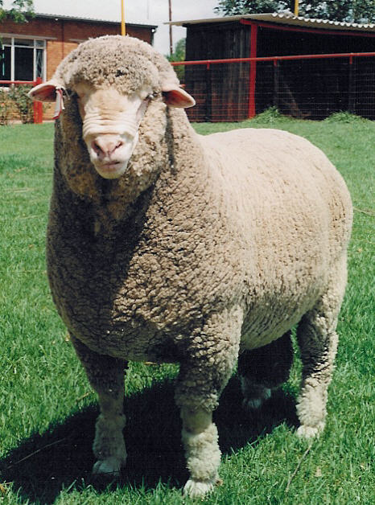
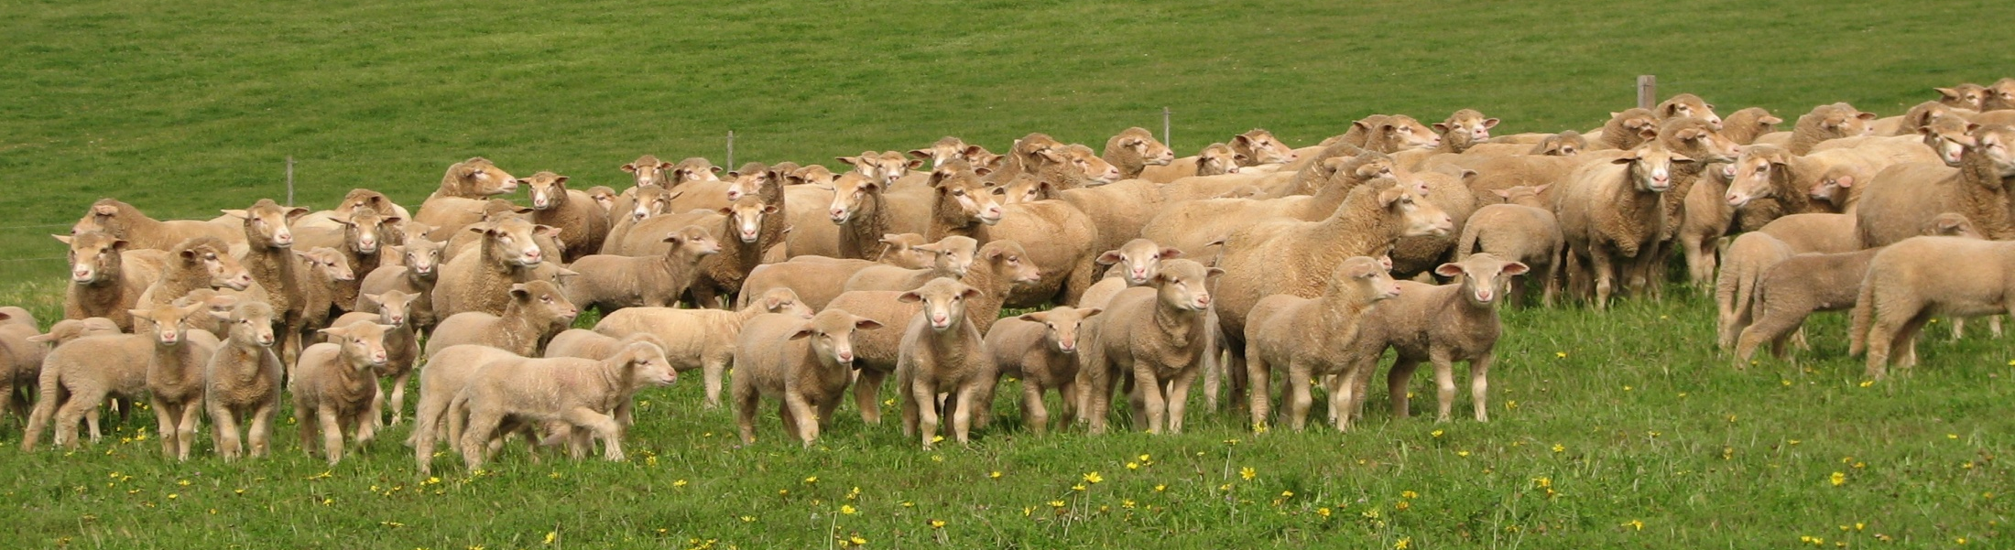
BREEDING OBJECTIVES FOR DOHNES
Fundamental objective—financial
To realise maximum profitability
Breeding objectives must aim at:
- Maximum return per unit of input
- Optimum production levels within
Environmental Constraints
- Optimum relationships between
Components of Income and Profits

Slide 9
Ratio of Meat : Wool
Income the most
Profitable Flocks
Meat 70 – 80%
Wool 20 – 30%

Slide 10
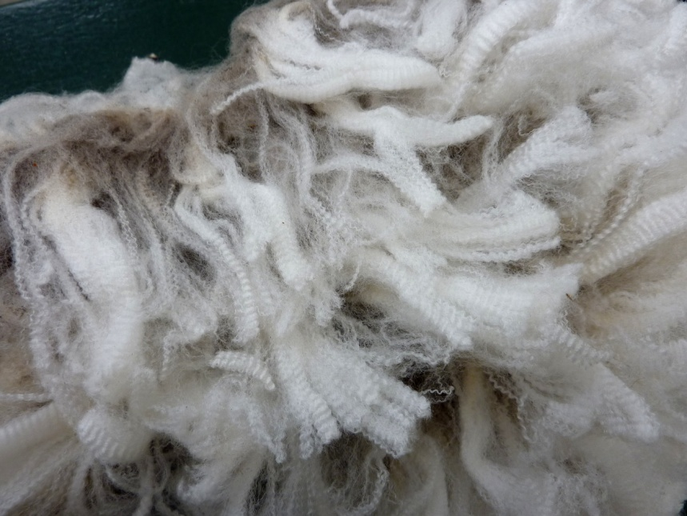
Meat/wool price ratio determines emphasis on traits that contribute to meat production:
- Prolificacy
- Lamb growth rate
- Conformation
- Carcass quality
There is no conflict between w wool and meat production in the same enterprise
Each has a stabilising effect on the other

Slide 11
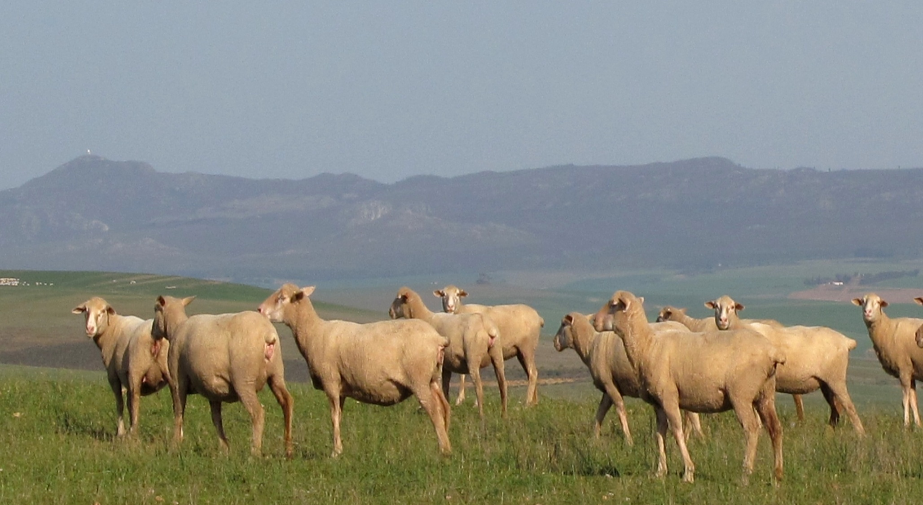
Breeding objectives must be
in Harmony with the Physical Environment:
- Reproduction and Growth are negatively influenced by an unfavourable relationship between Fleece and Body Weight
- Wool production potential (*WPP%)
inversely related to Fitness Traits in
sub-optimum environments (Herselman et al, 1993)
*WPP% = Clean Fleece Weight x 100
Body Weight
A favourable WPP% (5-6%) will enhance fitness,
adaptability and reproduction and growth

Slide 12
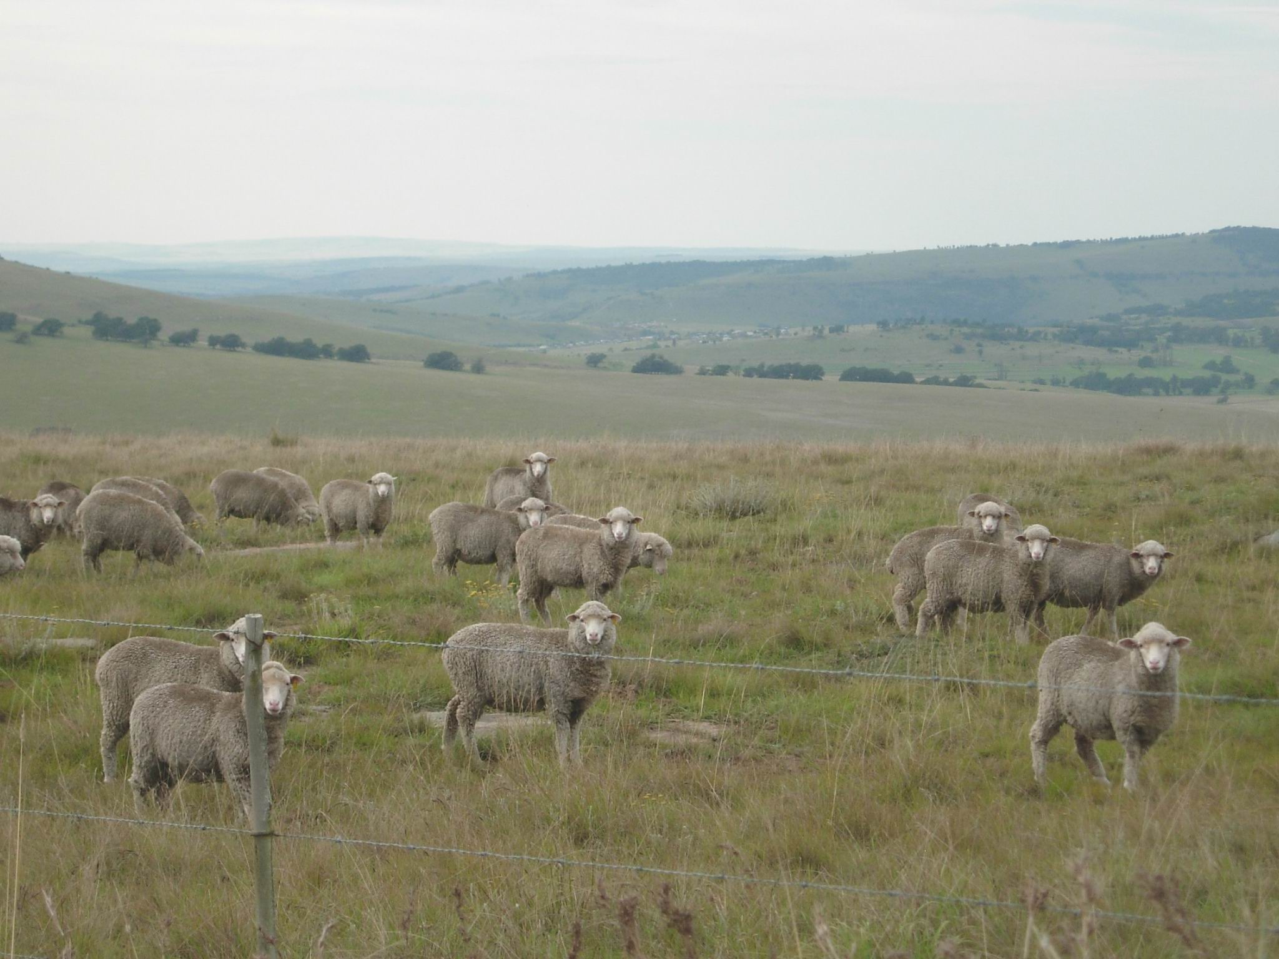
Breeding objectives must be
in Harmony with the Physical Environment:
- Reproduction and Growth are negatively influenced
by an unfavourable relationship between
Fleece and Body Weight
- Wool production potential (*WPP%)
inversely related to Fitness Traits in
sub-optimum environments (Herselman et al, 1993)
*WPP% = Clean Fleece Weight x 100
Body Weight
A favourable WPP% (5-6%) will enhance fitness,
adaptability and reproduction and growth

Slide 13
A critical analysis of sire performance resulted in a major modification the ram selection index in 1995. 93% of our 30 top sires were breeding excessive fleece weight . We had begun to deviate from the from the principle of true dual-purpose sheep..
Figure:
Henri Londt
From the 1990s wool was no longer the main income driver – it was meat.
The key to increasing profitability was the correct relationship between fleece weight and body weight – defined as Wool Production Potential.
WPP% = Clean fleece weight expressed as a percentage of body weight at test age

Slide 14
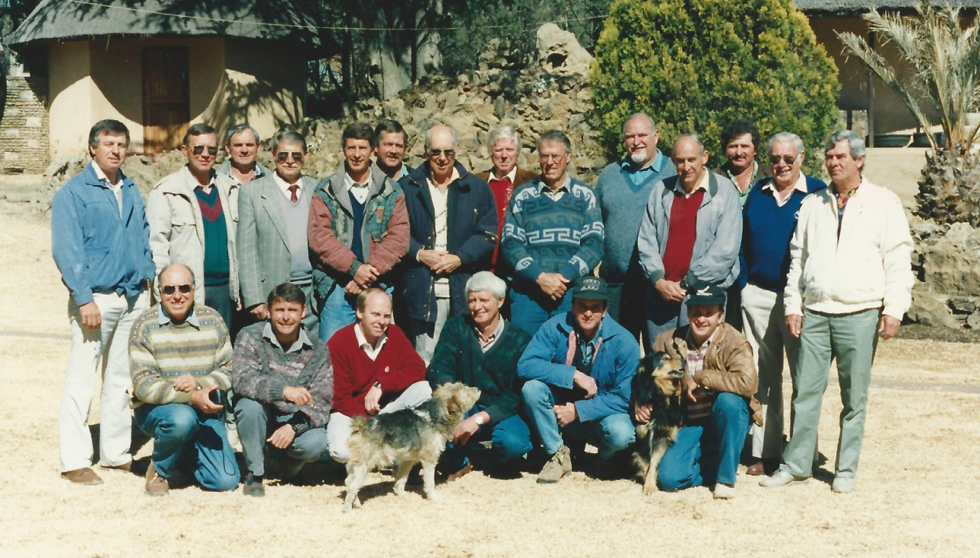
Targeted research by Wentzel (1991) Herselman et al (1993) revealed that excessively high fleece weight, relative to body weight, is negatively correlated with the traits that promote meat production – hardiness, reproduction rate and growth rate
Our sheep were probably already genetically capable of growing more wool than the environment could sustain, and this was impeding their potential for meat production.
At a workshop in 1995 we amended the selection index, reducing the fleece weight component and increasing the emphasis on fibre diameter.
The WPP% and fibre diameter declined, the fitness of our sheep improved dramatically as did lambing percentages and growth rate.

Slide 15
In 1996 the average WPP% of all Dohnes was 6.76%; the average lambing was 108%. Thirteen years later in 2009 the WPP% was 5.15% and lambing over all studs had risen to 141%!
While a proportion of the improved reproduction must be attributed to better management, there is nevertheless a strong relationship between reproduction and WPP%

Slide 16
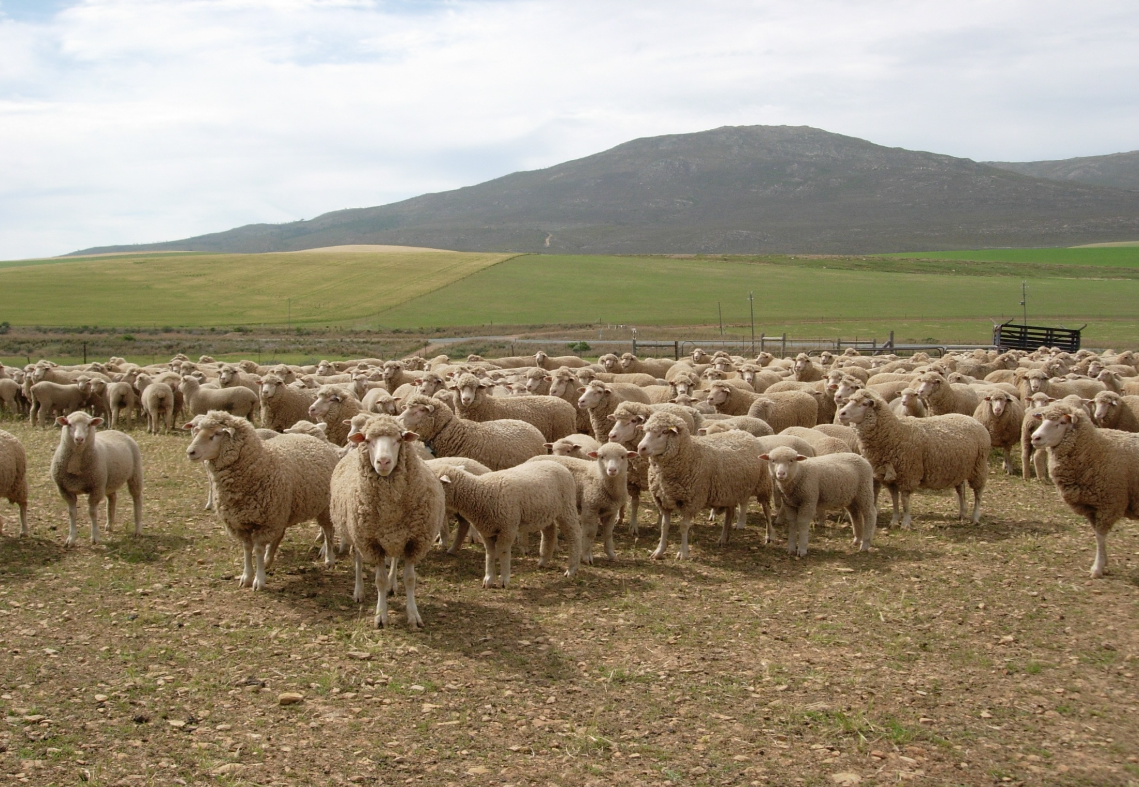
    BREEDING OBJECTIVES FOR DOHNES
The weight of lamb produced per hectare is the single most important factor that influences profitability
Priority must be given to traits that enhance
weight of lamb produced.
Hardiness and fitness (adaptability) have the greatest influence on lamb production and input costs -
Set as the first objectives
for Dohne Merinos in South Africa.

Slide 17
BREEDING OBJECTIVES FOR DOHNES
In order of priority, the objectives set are:
- Fitness traits - (WPP%)
PROMOTES EFFICIENT LAMB PRODUCTION
PROMOTES EASY CARE
FACILITATES HIGHER STOCKING DENSITIES
CUTS COSTS
- Reproduction and maternal ability
FERTILITY
FECUNDITY
MATERNAL TRAITS AND MILK PRODUCTION
LAMB SURVIVAL
- Lamb growth rate (BW at 100 and 365 days of age)
    - Fibre Diameter and Clean Fleece Weight
    PRIORITY TO FLEECE TRAITS THAT ADD VALUE:
    FINER WOOL AND HIGHER QUALITY

Slide 18
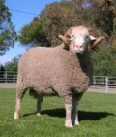

Classification of the potential of the different breeds of sheep for fine wool and heavy lamb production
Meat
Weaning weight (kg)
Dual purpose
Meat producers
Dual purpose
Milk producer
25
Dual purpose
Wool
Milk
23
Wool (µ)
Design: Alfonso Bouroncle and William Vivanco

Slide 19
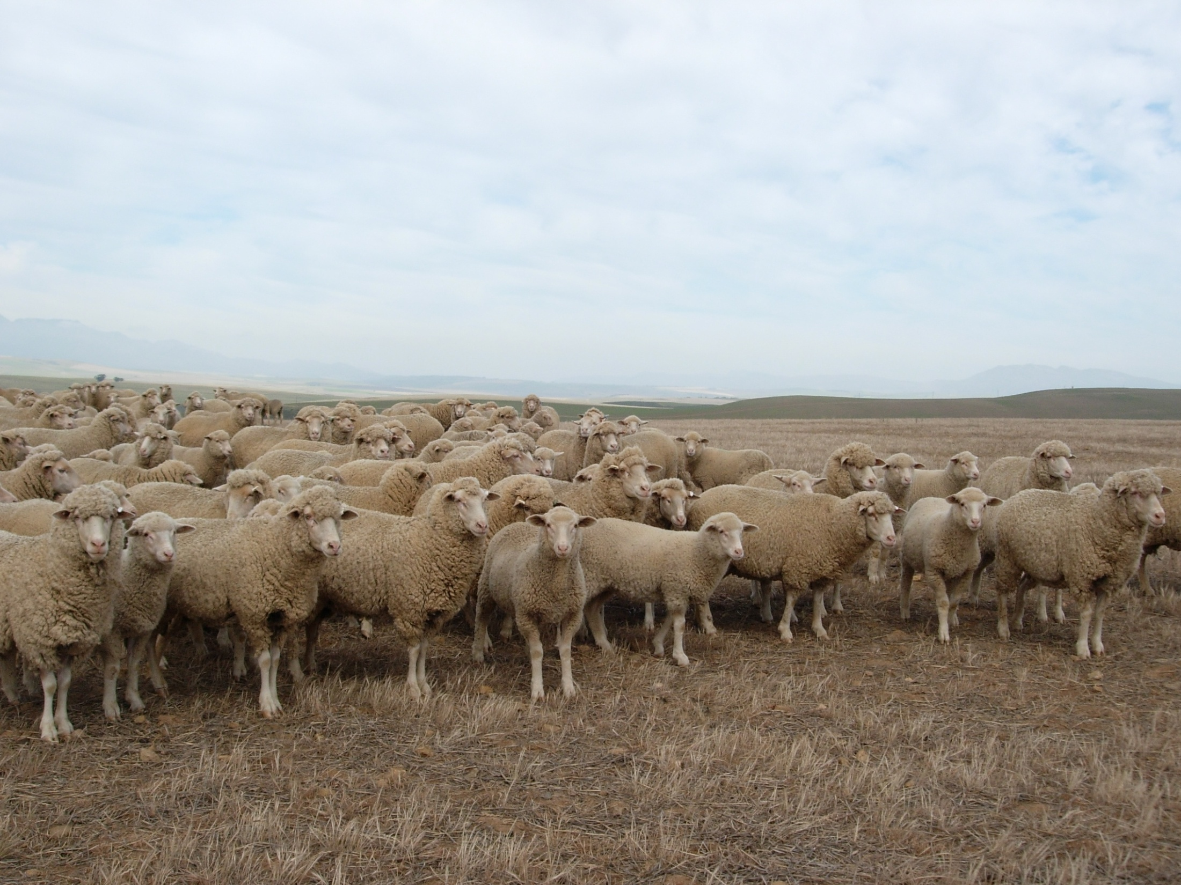
A New Philosophy
Wool production is no longer the most important component of Flock Income
Fleece weight is no longer the major selection objective
A new multidimensional philosophy in terms of breeding goals and selection
strategy for Commercial Sheep is necessary to Maximise Profitability in
current and future market environments
Dohnes will add a new and profitable dimension to
your sheep enterprise
Cameron McMaster

Slide 20
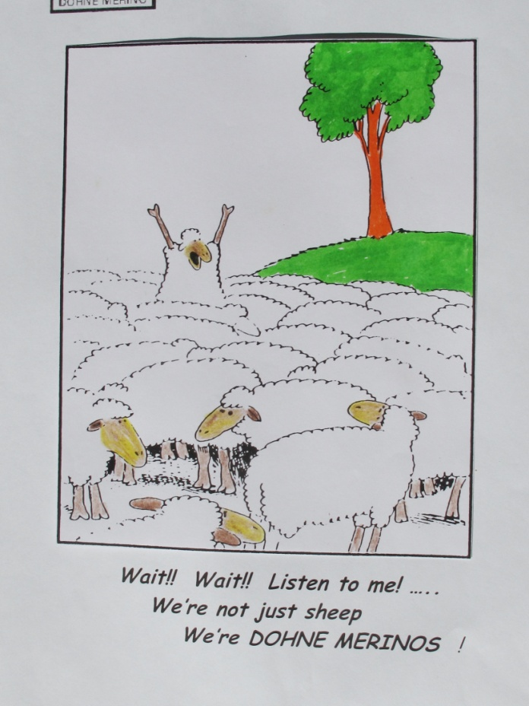
SUMMARY
In efforts to increase flock income from
higher lamb and meat production - Choice of Breed-type is
important
Dohnes are appropriate in the current Economic Environment
Current market indicators and demand for
lower costs indicate:
Selection for Better Adapted sheep
Selection for Higher Reproduction
Selection for Higher Early Growth Rates
Selection for Wool Quality traits
rather than higher fleece weights

